Slide 1
NBA Game Predictor
By: Logan, Alan, Elias, Phat

Slide 2
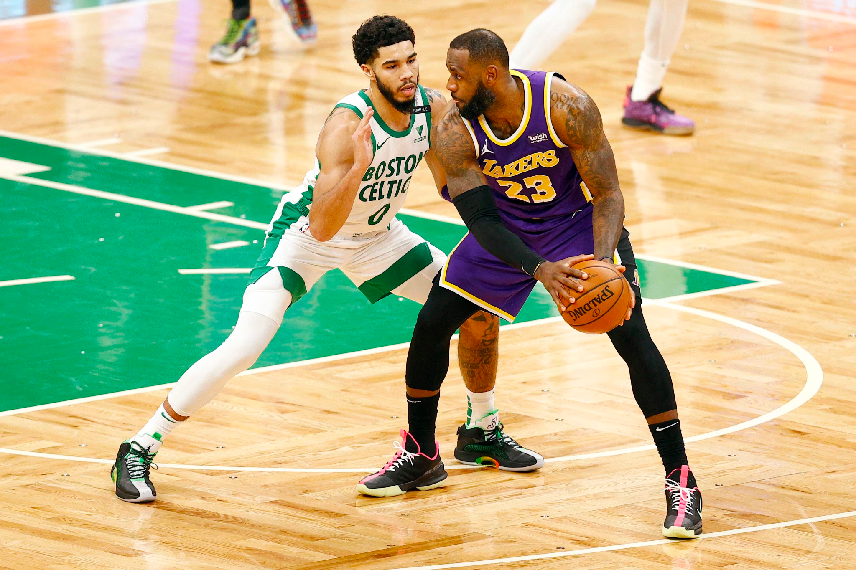
Introduction
The NBA is a professional basketball league in the US. It is the most popular basketball league in the world, with an average of 1.6 million viewers a day.
Every NBA game matches two teams, with one winner and one loser. There 82 games in a regular season and a multiple best of 7 games for the playoffs. We want our model to predict these games before they happen.
Our project focuses on using unique machine learning classifiers to predict the outcome of NBA games using previous season games and player data.
Our goal is to match or surpass the Industry’s most accurate NBA game prediction model of 70%.
According to a scientific paper by Stanford on NBA Game Predictions with Player Chemistry, the most accurate machine learning game prediction models for the NBA score a 65-70% accuracy.

Slide 3
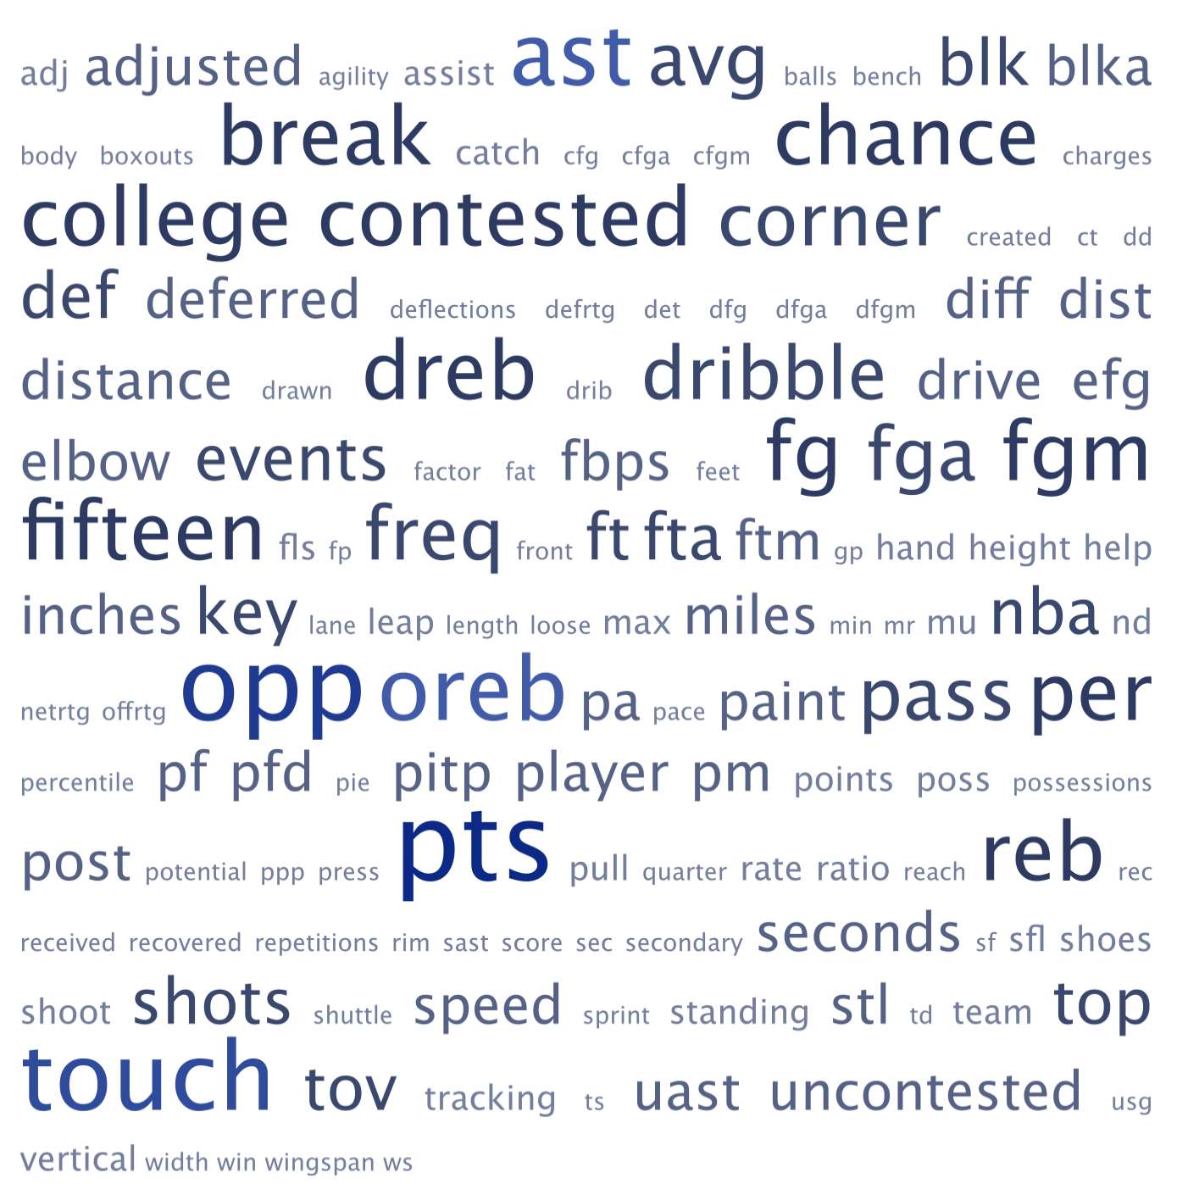
Potential Challenges
Predicting NBA Game Outcomes has many potential problems that need to be addressed:
Injuries occur all the time in sports, which can also mean a team losing high-impact players.
Teams form changes throughout the season, possibly increasing quality of play depending on caliber of games.
There is a large amount of NBA data so we will need to choose a proper scope.
Trades can happen mid-season- affecting the talent level of a team.
On the NBA site alone, there is over 200 categories of player data. We need to compact our data into meaningful information for our model.

Slide 4
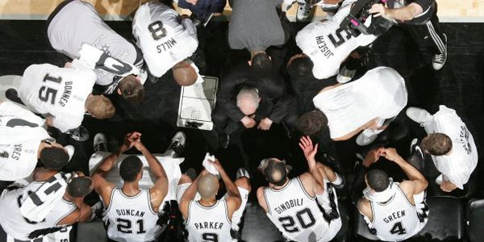
Proposed Solutions + Limitations
We want to factor in as many features as possible into our model to potentially increase our prediction stability and accuracy:
For injuries, we will use player’s career numbers to determine a player’s durability and availability throughout the season.
To consider team form, we track a team’s performance in the past 10 games.
To mitigate the issue with NBA having large amounts of data, we will base our model mainly on the highest impact statistics that have the most impact on team winning a match.
For game data, we will use game logs from the 2015-2020 season, which is a reasonable scope.
Injuries and team form are two major factors that we need to consider to stabilize our prediction model. It will be considered as part of our feature engineering.
Limitation: Mid-season trades are a factor too, but trades are highly complex and will need to be considered as a feature for future works.

Slide 5



How did other models do?
Over/Under NBA Predictor
by Ben Jensen
Used NBA game log as data
Used Gradient Boosting Regressor for a 58% accuracy
NBA Future Game Predictor
by Vikas Paruchuri
Used Game Log from 2017-18 season to predict upcoming game results
Achieved a 63% accuracy with a Ridge Regression Model
NBA Game Outcome Predictor
by Josh Weiner
Used NBA Season Records of teams from 2008-09 to 2019-20
Achieved a 67% accuracy with RandomizedSearch model.

Slide 6
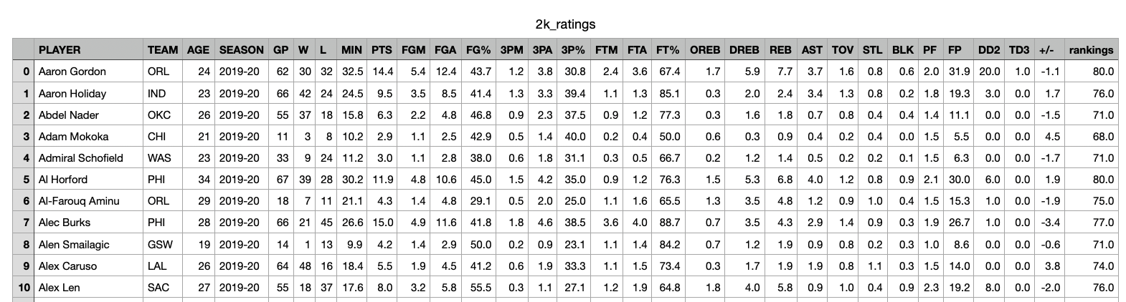
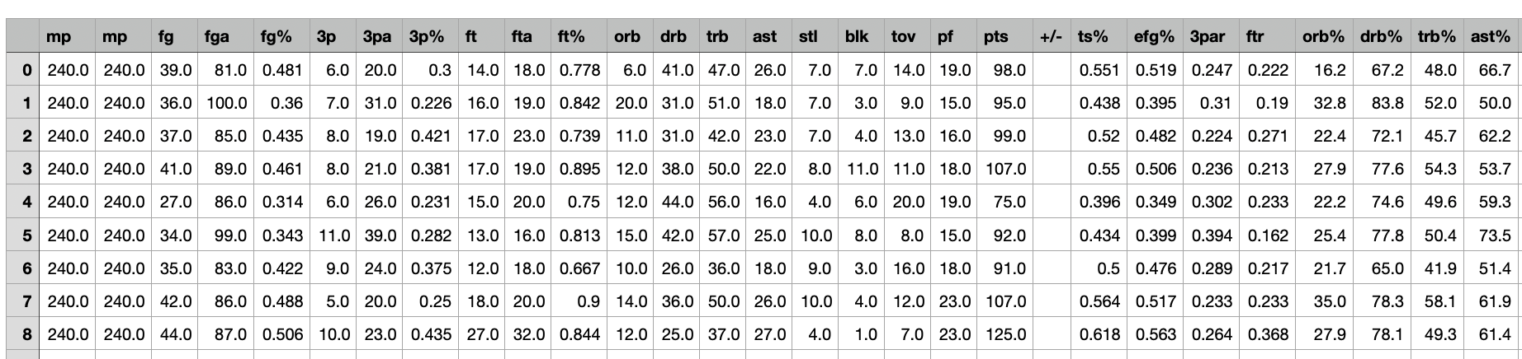
Starting Data
Our NBA Game Prediction model will use data from a previous NBA season to predict future games during the same or future season.
Season Game Logs from 2016-2020 season the find how teams perform vs. other certain teams.
Player Skill Level Ratings, game statistics, organized with NBA2K Ratings.
(Will show you more about the data on the next two slides!)
Sample of our Game statistic + Player statistics/skill rating datasets

Slide 7
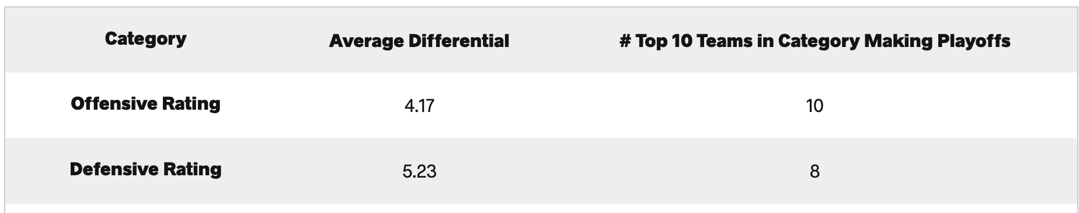
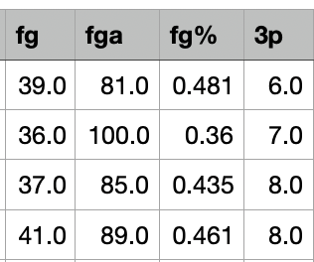
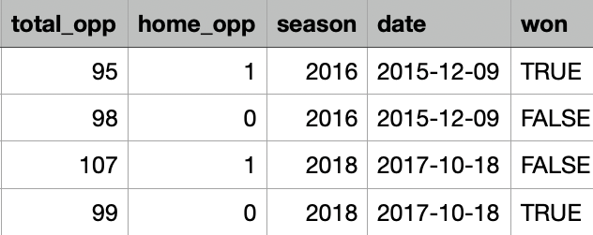
Dataset #1: Game Statistic Logs
Key Points:
Our Game Logs have statistics on every team’s performance for every game in the 2015-2020 NBA Seasons.
Each row is game statistics for a team’s performance, including key statistic categories to outcomes.
We will take advantage of team statistics by tracking their performance in the previous 10 games for predictions.
This game log data will be used to train and test our model, our target variable will be predicting who won.
Key categories for winning include Offensive Rating and Defensive Rating. The best teams in the NBA (highest winning %) excel in these categories. We want to factor the most important features in this dataset into our model.
← first 4 feature | last4 ->
Number of Rows: 8949
Number of Columns: 82
TARGET

Slide 8
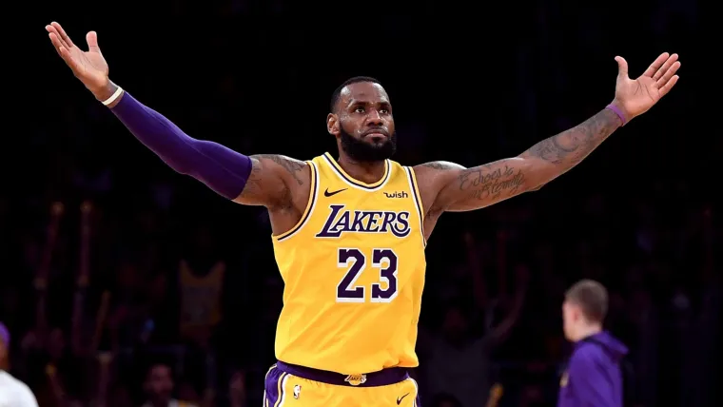
Dataset #2: Player Statistics
Key Points:
Our Player Skill Statistic Dataset has statistics on every player by season on their numerical averages
Each row is one player’s year with a team, including their win/loss ratio, categorical data, percentages, +/-, and overall player rating(out of 100)
We will use player statistics to help create skill ratings for our players later.
+/-, age, and games played can also be used in our feature engineering.
Example: 2019 Lebron James had a skill rating of 97/100, making him one of the biggest contributors to his team’s ability to win games.

Slide 9
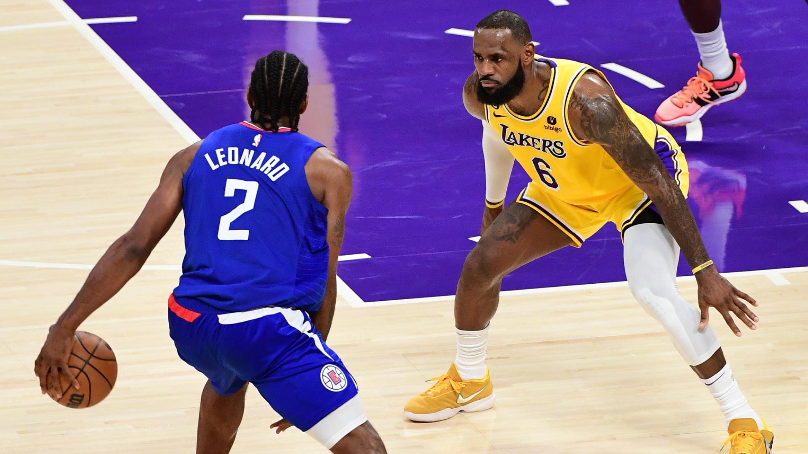
Data Preprocessing
Null Values/Noise?
After analyzing the data and checking for any null values and noise, there seemed to be no inconsistencies in the data that may have result from measurement errors or data entry mistakes.
This is due to the fact that NBA cleans their data regularly such as post game adjustments to ensure data cleanliness and quality.
Our dataset selection of player statistics and game logs are from completed NBA seasons, making our data clean and whole.

Slide 10
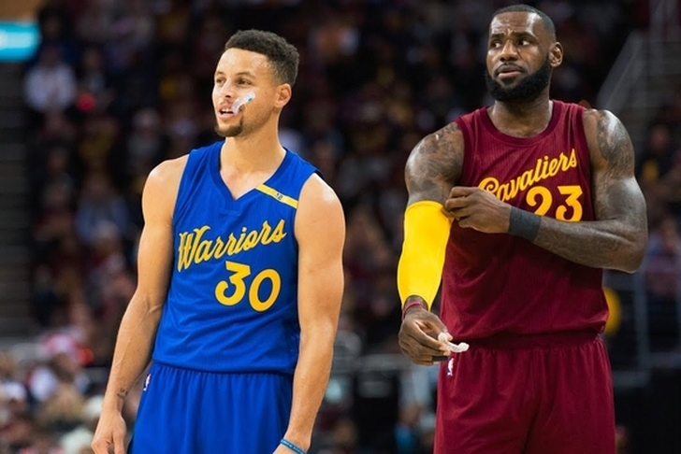
Feature Engineering
Our initial data is not specific enough to what features can help tell us who has a higher chance of winning a match. So, we created our own features based off the data- they are all in numerical format of integer or float.
Average Offensive/Defensive Rating
Home Field Advantage
Team Form(Last 10 Games)
Injury Rating
Plus Minus Average Performance of Team
Team Age
Average Team Skill Rating
Number of Superstars
Max Player Rating
In basketball, NBA teams win 62.7% of their home games.
It’s important to keep track of a team’s consistency at home
to help support or model’s decision.
(Source: Chicago Booth Sports Research)

Slide 11
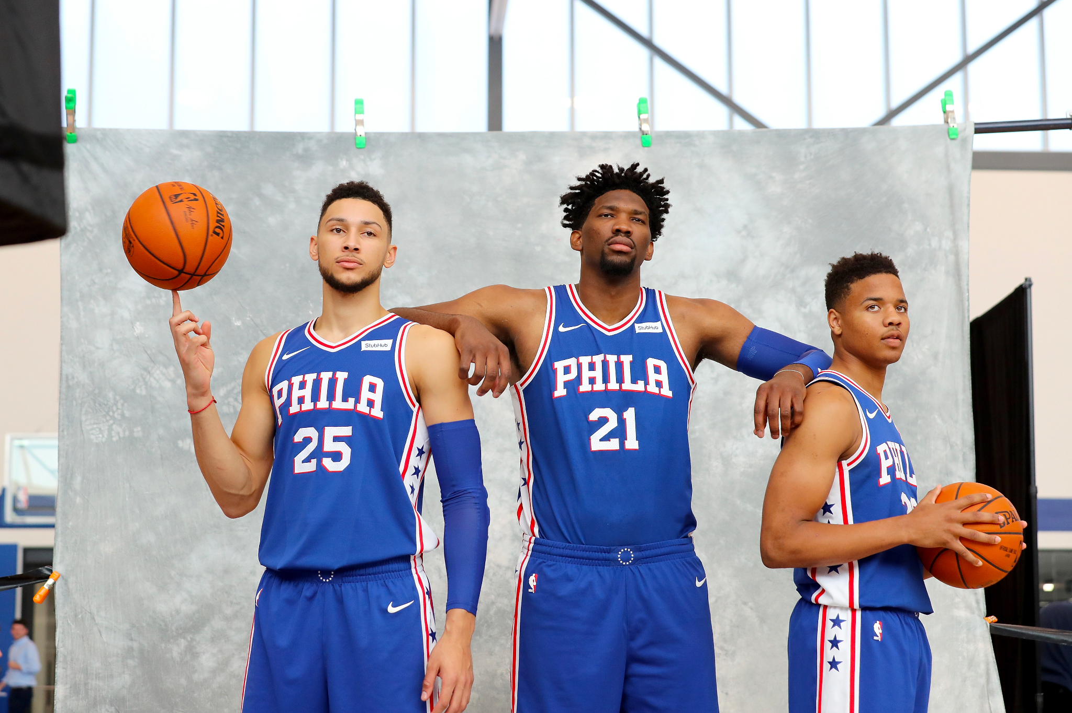

Feature Engineering: Injury Rating
NBA Seasons are full of injuries for every team. Injuries to impact players can dramatically impact the chance of a team winning a game.
We engineered a durability rating for each team by season to consider injuries in our model decision making.
Durability scores for each team are calculated by:
for each player on the team all the way up to the currently predicted game’s time.
The 2017-18 76ers had one of the lowest durability ratings of 6.3: Their starting 5 alone already missed over 100+ games the year before, including 50 games missed by superstar Joel Embiid.
Player amount of games played
—----------------------------------------
total possible games.
The 2017-18 Warriors had a very high durability rating of 9.3 due to their top star players + bench playing over 90% of their games in recent years.

Slide 12
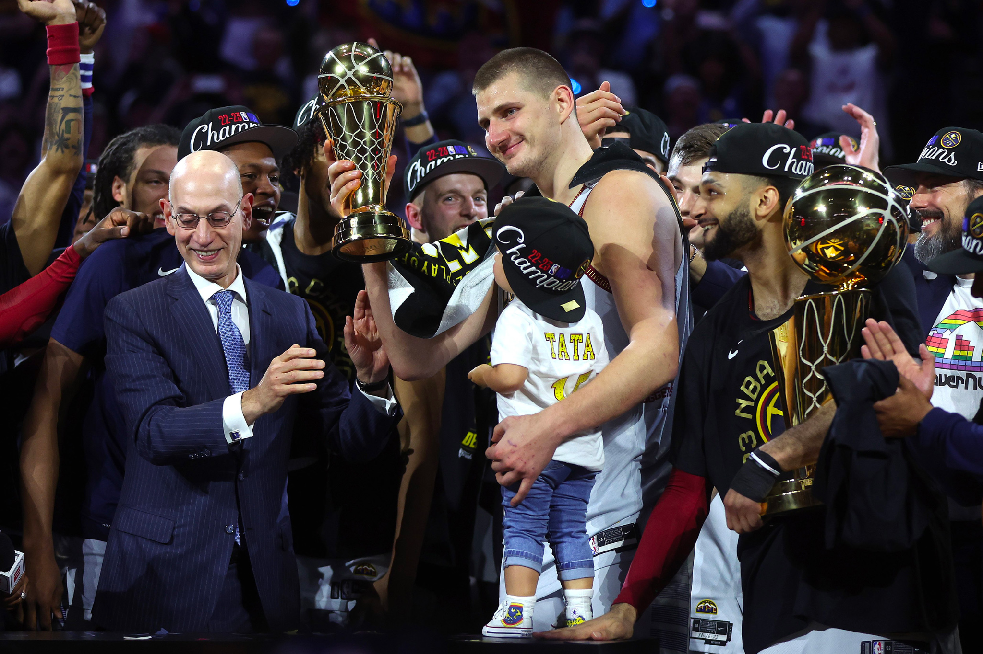
Feature Explained: In-Season Form
Furthermore, we wanted to measure a team’s rolling average to measure their current form in the season. This will have the ability to measure any cold or hot streaks that the team may be going through as the season is extremely long and taxing to the players. Thus, we measured the following:
Average Offensive Rating in the Last Ten Games
Average Defensive Rating in the Last Ten Games
Games Won in the Last Ten Games
Home Field Advantage
(We altered our dataset by creating a rolling average/total of the last ten games within our dataset)

Slide 13

Feature Explained: Average Age
Another feature we wanted to add was the average age of the team. As our model’s accuracy started to plateau at a certain point, we wanted to add this feature to see if there were any changes in accuracy. Although there wasn’t, we believe it is still an important feature to discuss for the following reasons:
Aging can cause players to be more susceptible to injuries as there is more wear and tear on the body throughout playing every year.
Aging also means experience, so certain players know how to win games at a high-level due to understanding offensive and defensive schemes.
Many players go through a certain age period where they hit their prime which means they have both the body and experience to excel.

Slide 14
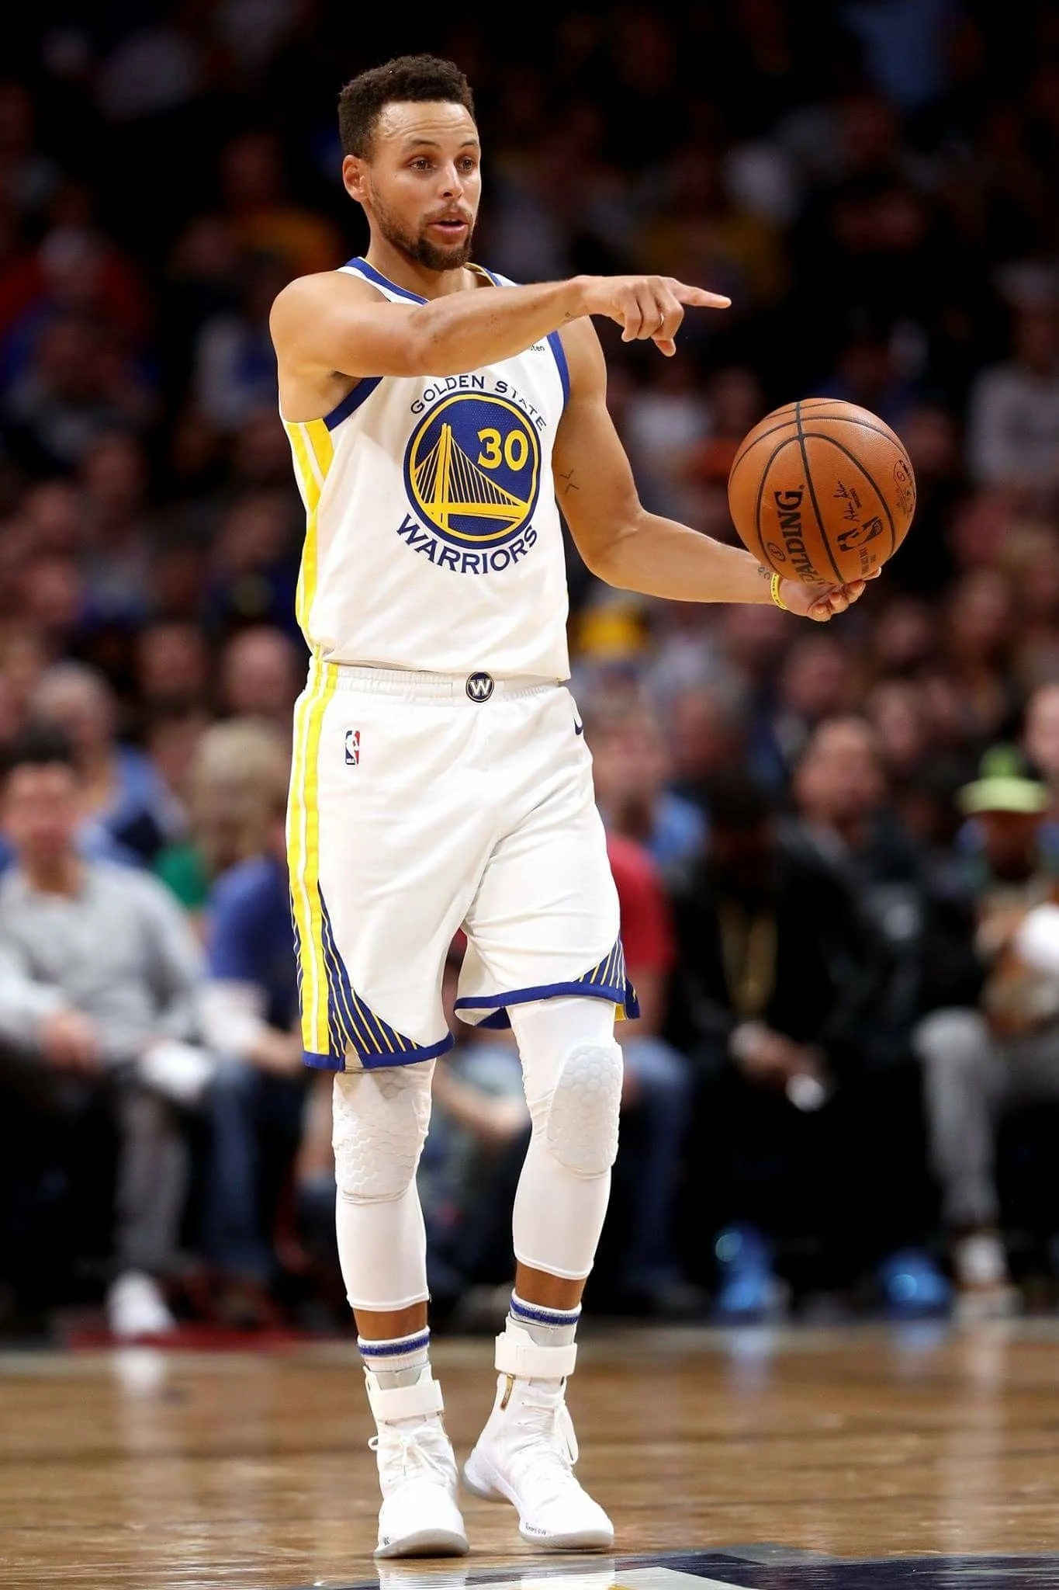
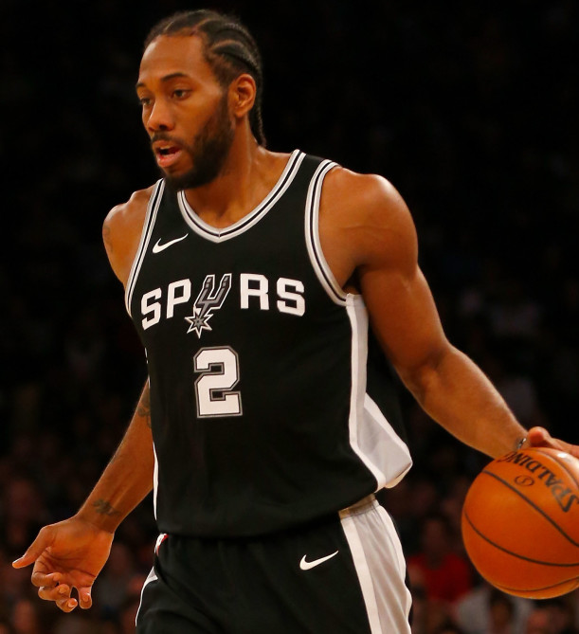
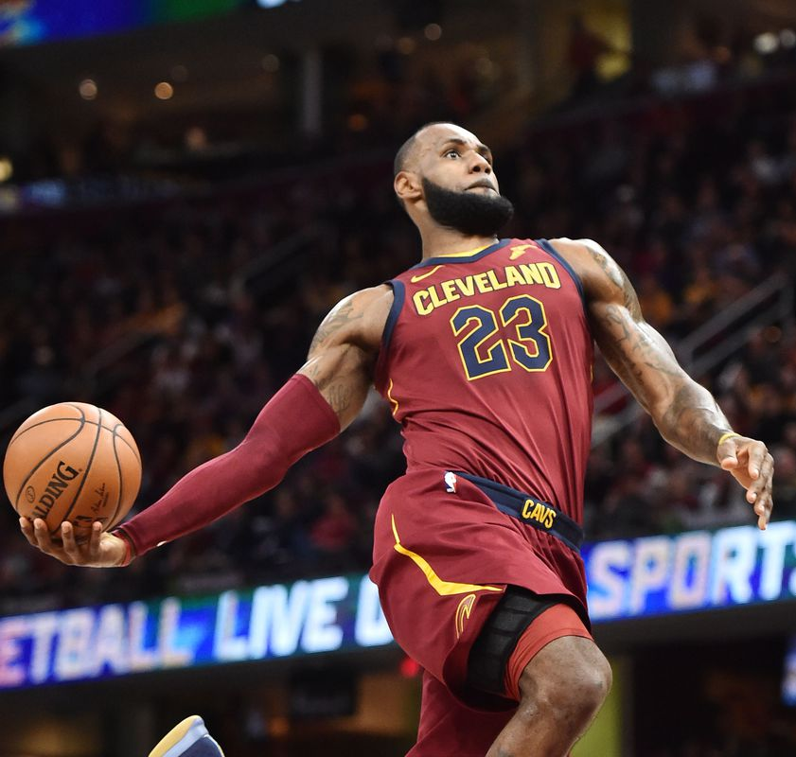
Feature Engineering: Skill Rating
Player Skill Rating takes into consideration a player’s talent, career statistics, and accolades into one compact number out of 100.
Multiple Player Skill Ratings can be used to calculate the average skill rating of an entire team.
Career statistics that directly impact winning or losing a match includes the +/- rating, which represents how much their team wins or loses by when the player is on the court.
Superstar-loaded teams typically win more games. We are counting the number of superstars on a team and the max player rating to factor into our model’s decisions.
94
97
Example of individual player skill ratings for some of the NBA’s best players.
97

Slide 15
Methodology
Model Development:
Baseline Models (no tuning): Logistic Regression, Random Forest
Tuned Models: SVC, Random Forest, XGBoost, Ensemble Voting, Stacking Classifier
Cross-Validation: 5-fold and 10-fold
Scaling data
Hyperparameter Tuning (varied depending on model to optimize performance)
Evaluation Metrics:
Primary:
Accuracy
Secondary:
Precision and Recall (to minimize false predictions)
AUC Score and ROC Curve (to evaluate model discrimination capability)

Slide 16
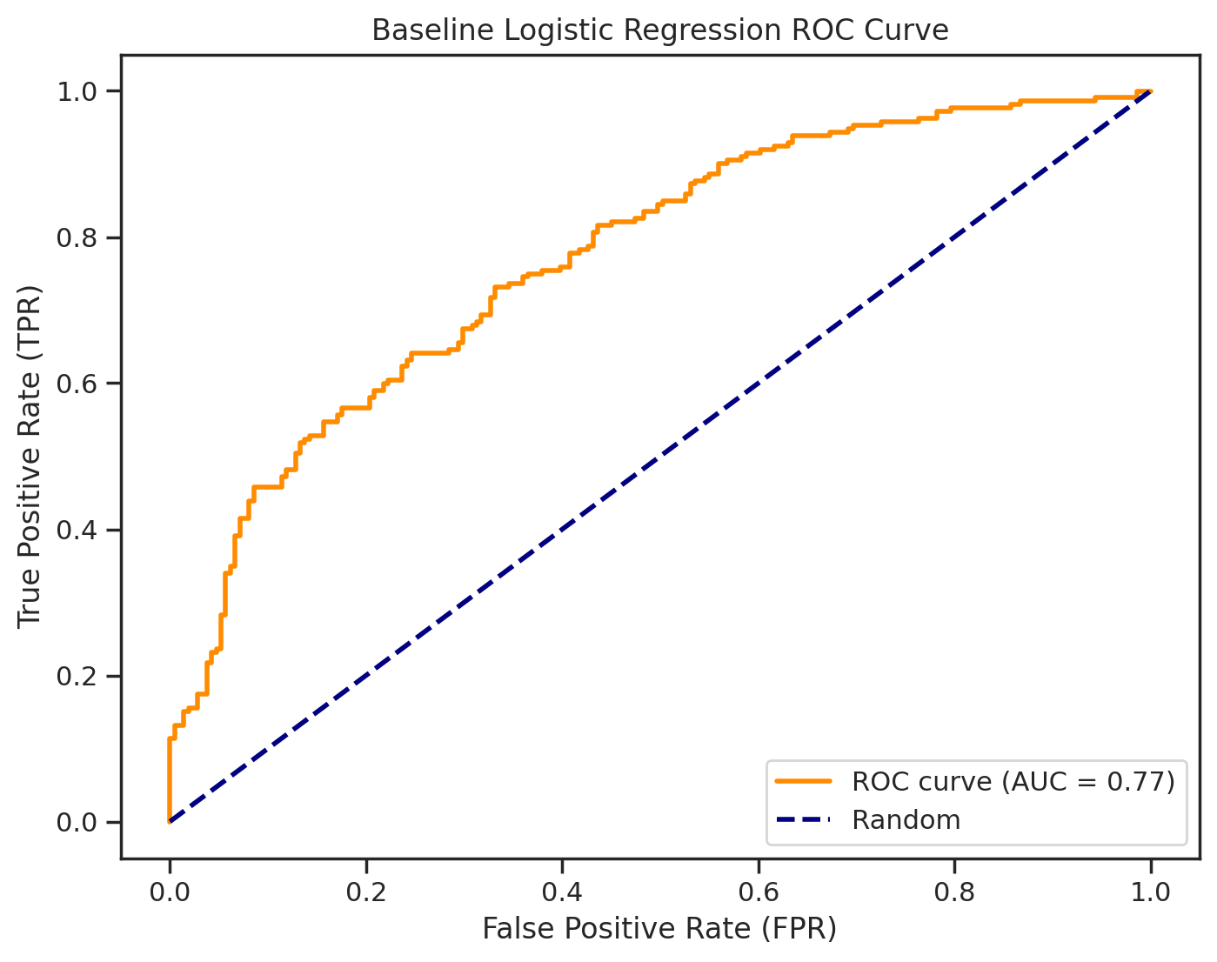
Logistic Regression
Model Features:
Designed for Binary Classification
Resistant to Overfitting
High Performance Efficiency
Model Customization:
None (used as a baseline)
Model Results:
Accuracy for Logistic Regression: 0.68

Slide 17
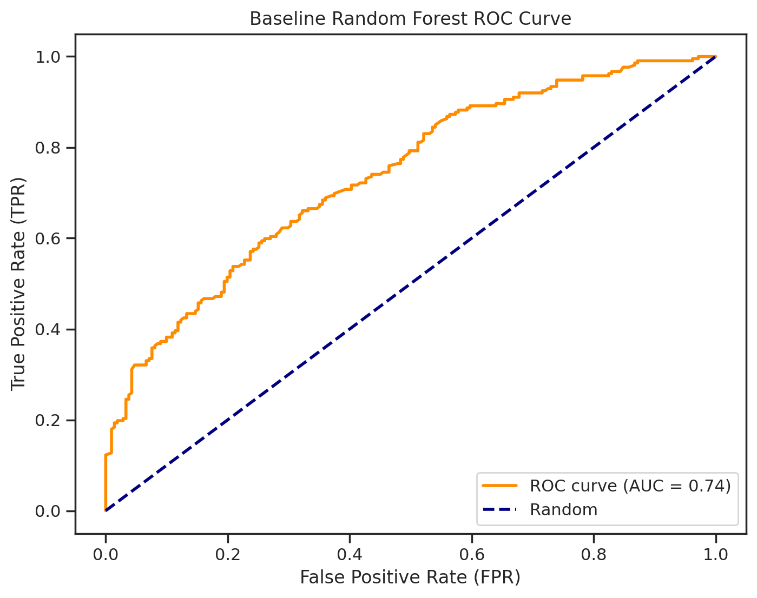
Random Forest (baseline)
Model Features:
Designed for Binary Classification
Resistant to Overfitting
Suitable for handling large datasets with
numerous features
Model Customization:
None (used as a baseline)
Model Results:
Accuracy for baseline Random Forest: 0.67

Slide 18
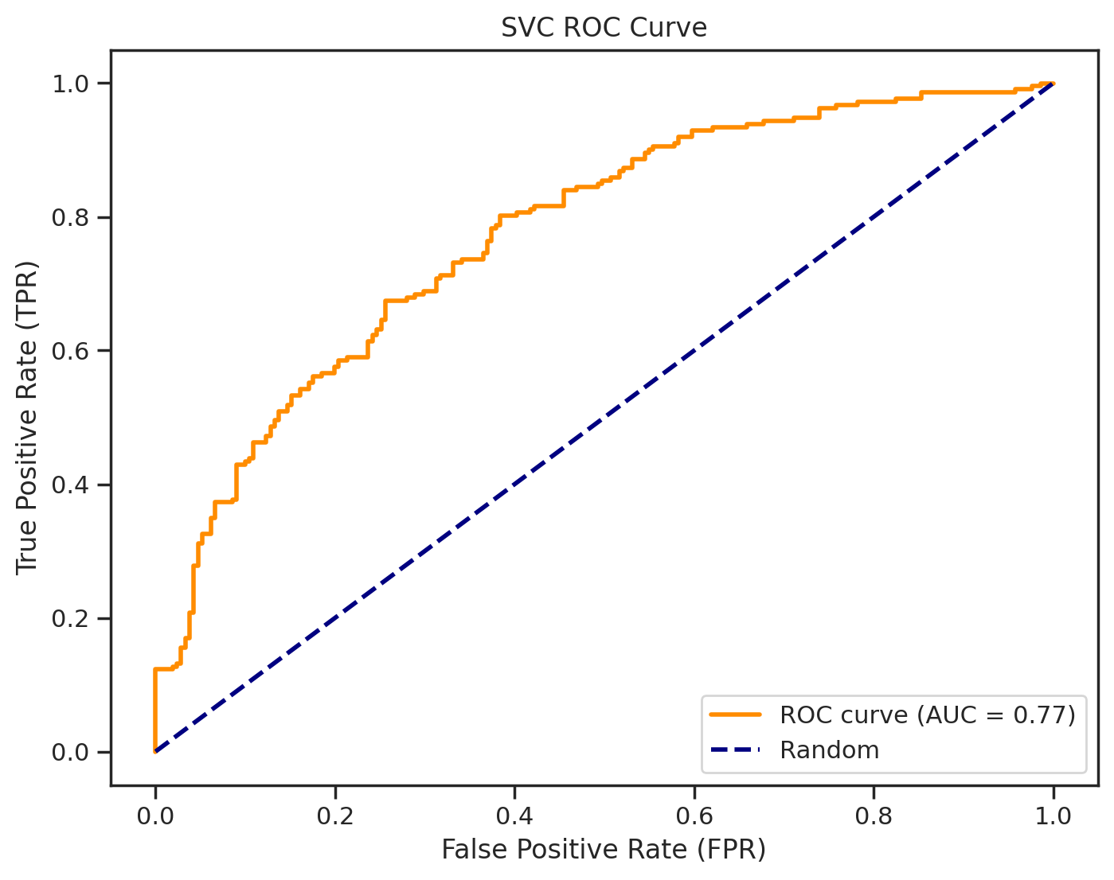
SVC
Model Features:
Designed for Binary Classification
Resistant to Overfitting
Utilized feature scaling (SVCs prefer)
Model Customization:
Scaled features
Grid Search + Hyperparameter tuning
Model Results:
Accuracy for SVC Classifier: 0.697
70% Accuracy!
'C': [0.01, 0.1, 1, 10, 100],
'kernel': ['linear', 'rbf', 'poly', 'sigmoid'],
'degree': [2, 3, 4],

Slide 19
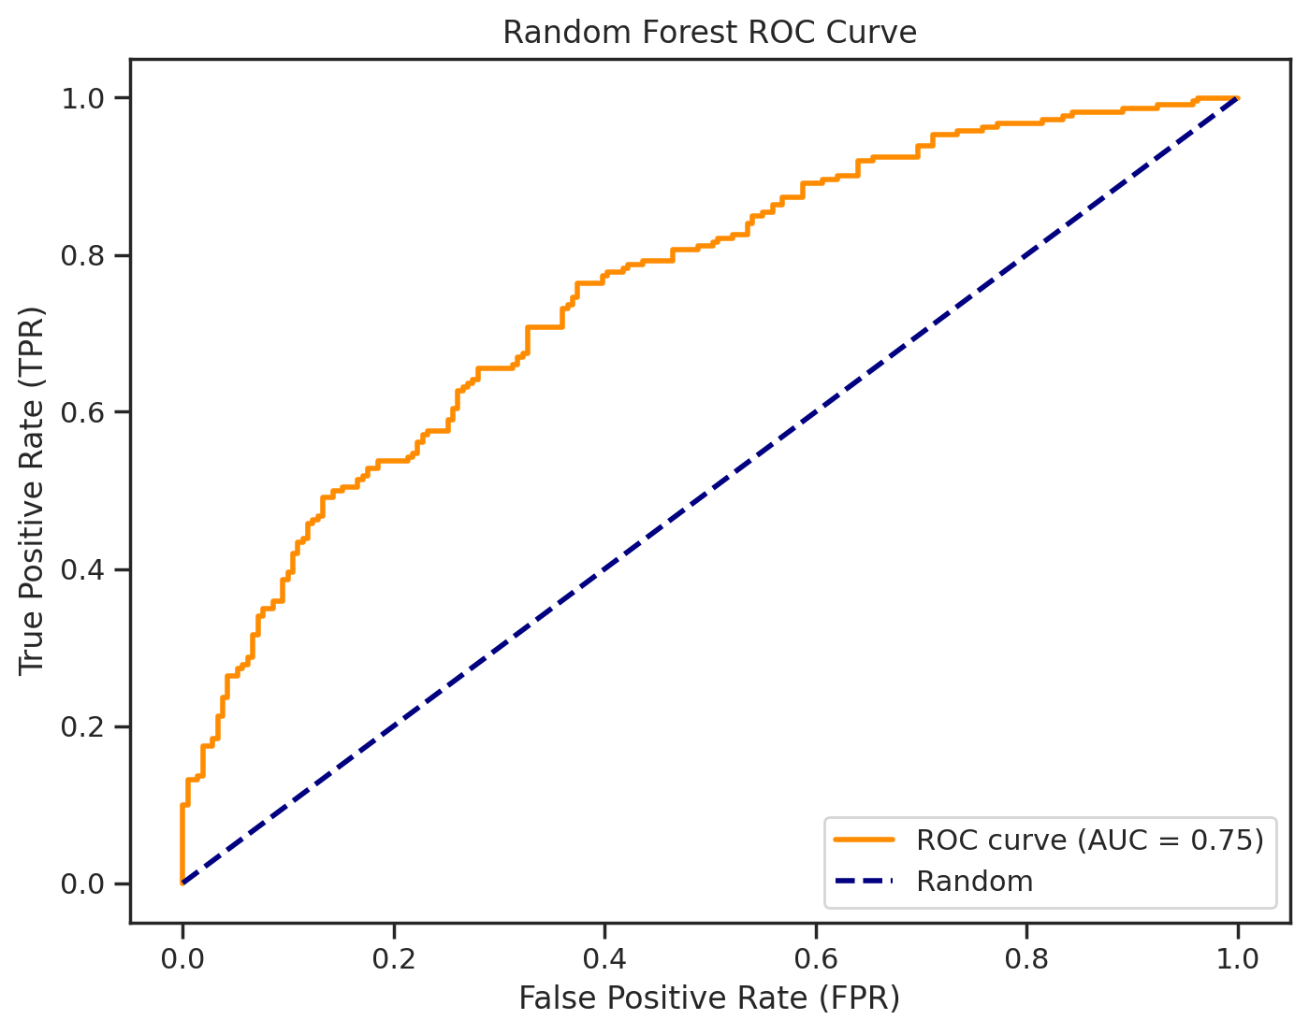
Random Forest (tuning)
Model Features:
Ensemble method - combines weak learners
Resists Overfitting due to Noise
Highly flexible and accurate
Model Customization:
Scaled features
10-fold CV
Grid Search + Hyperparameter tuning
Model Results:
'n_estimators': [50, 100, 200],
'max_depth': [3, 5, 8, 12],
'max_features': [6, 9, 12, 15]
Accuracy for Random Forest: 0.678

Slide 20
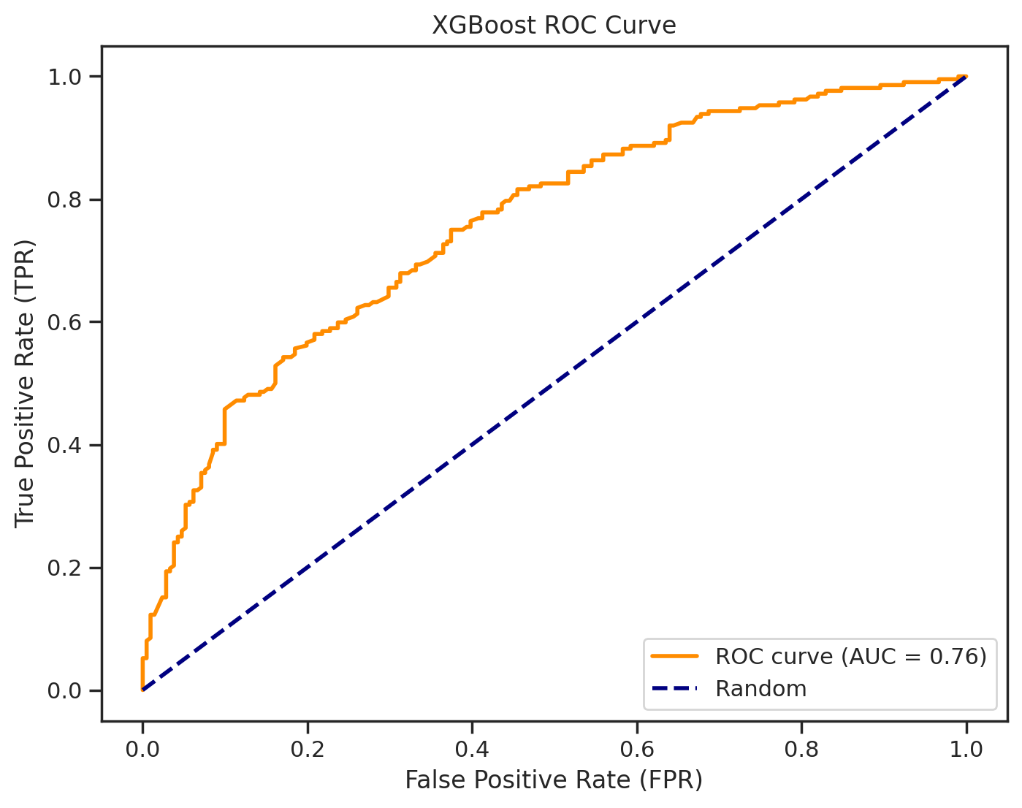
XGBoost
Model Features:
High Performance Efficiency
“Pruning” - removes unnecessary branches
Ensemble method - combines weak learners
Model Customization:
10-fold CV
Grid Search + Hyperparameter Tuning
Class Rebalance: SMOTE
Model Results:
Accuracy for XGBoost Classifier 0.678
'n_estimators': [50, 100, 200],
'max_depth': [3, 4, 5],
'learning_rate': [0.005, 0.01, 0.1, 0.2],
'subsample': [0.8, 0.9, 1.0],
Notes:
Elias Start

Slide 21
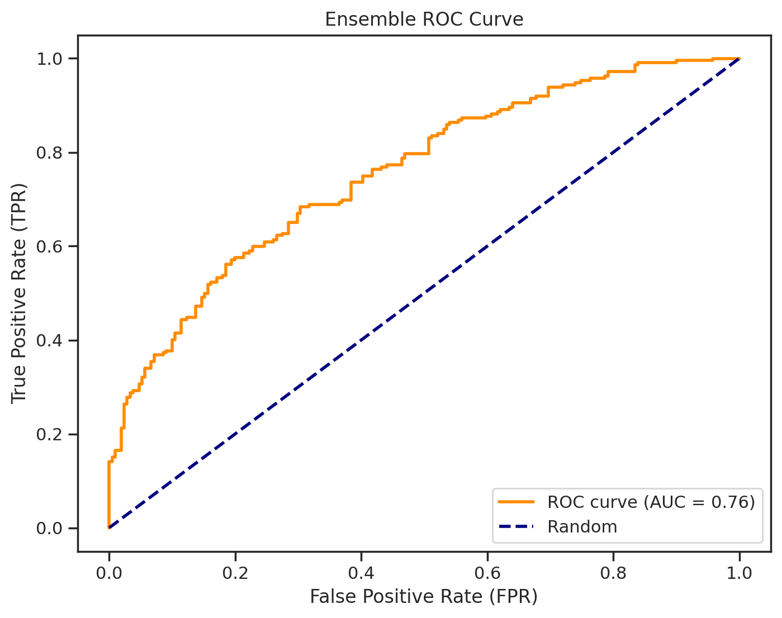
Ensemble (Voting Classifier)
Model Features:
Combining Models = Improved Accuracy
Diversity of Models
Resistant to Overfitting
Model Customization:
10-fold CV
Grid Search + Hyperparameter Tuning
Model Results:
Accuracy for Hard Voting: 0.678
Accuracy for Soft Voting: 0.688
'ensemble__svc__C': [0.1, 1, 10],
'ensemble__rf__n_estimators': [50, 100, 200],
'ensemble__xgb__max_depth': [3, 5, 7]

Slide 22
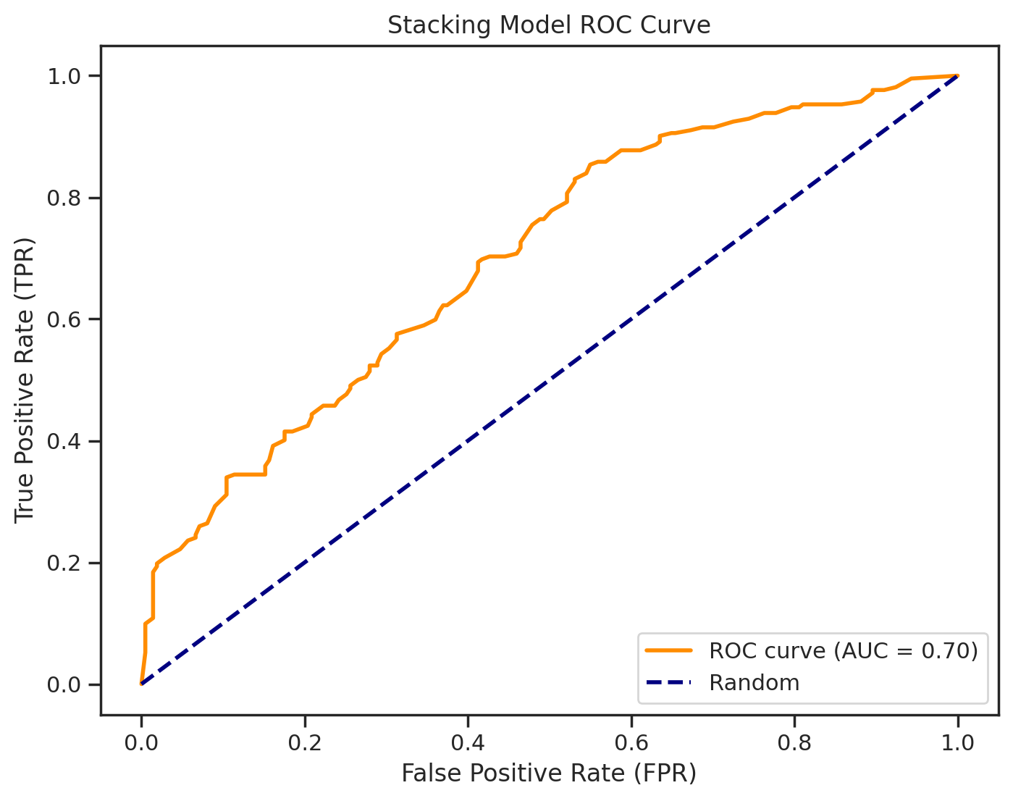
Stacking
Model Features:
Diversity of Models
Stacking method - combines weak learners
Model Customization:
5-fold CV
Stacked GradientBoost, Adaboost, XGBoost
Random Forest as Final Estimator
Grid Search + Hyperparameter tuning on all classifiers
Model Results:
Accuracy for Stacking Model: 0.63

Slide 23
Conclusion/Analysis of Models
Why did SVC perform well?:
Engineered for Binary Classification
Complex and Non-linear decision boundary
Captures complex features well
Why did Boosting, Ensemble, and Stacking underperform?
Boosting / Ensemble weak learners might not have seen relationships in complex data like SVC could
Non-linear decision boundary
Possible overfitting led to weak generalization
What season gave the best accuracy rating?
The 2015-2016 NBA season gave the best accuracy rating which was due to the fact that the NBA was top-heavy and only had a handful of well-developed teams.

Slide 24


Future Works?
Dynamic Seasons with Real-Time Data
Over and Under predictions to enhance betting experience even more.
Predicting Future Seasons with Development Projections (Time Series Forecasting)
Back-to-Back Games Feature
More Features, Advanced Data
Factoring in-season trades
(Note: However, due to the league becoming more competitive and having more parity, predictions will be much more difficult to calculate, and other factors need to be considered for further improvements)

Slide 25
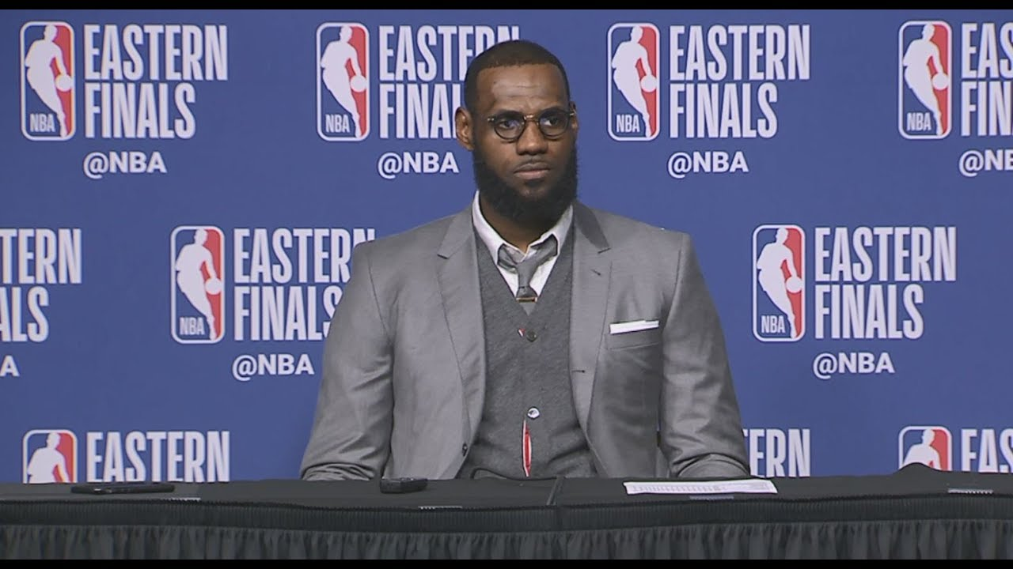
Thank you! Questions?

